Slide 1
WH
QUESTIONS
WH
Questions

Slide 2

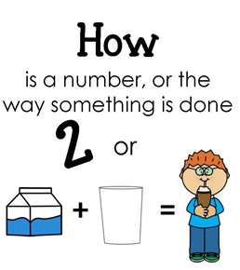






Slide 3
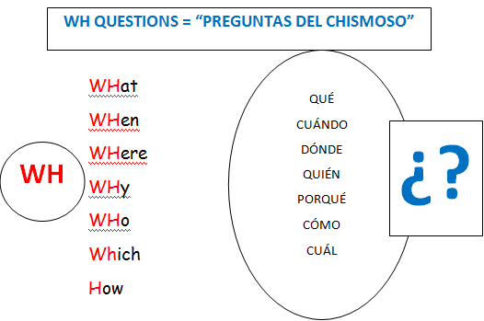


Slide 4
Let`s ask questions !!!
WH
____ is your favorite food?
WHICH
WHEN
____ Is your birthday?
WH
YOUR AUDIOS
WH
WHERE
____ are the car keys?
WH
WHY
____ are you bored?
WH
WHO
____ is at home?
WH
WHICH
____ music is better, Salsa or Merengue?
WH
WOH
____ was the concert?

Slide 5
Your turn…
Let`s ask questions !!!
WH
____ is your favorite color?
WHat
WHen
____
WH
Is your graduation?
WH
WHere
____ are the home keys?
AUDIOS
WH
WHy
____ are you happy?
WH
WHo
____ is at clasroom?
WH
WHich
____ music is better, corridos or rap?
WH
How
____ was the class?

